Slide 1
Real-Time Object Recognition in Urban Environments Using YOLO
MSCS3806
Hsiao-Chen Huang Jiacheng Weng

Slide 2
Outline
Problem Definition
Dataset and Experimental Setup
YOLO Model Architecture
Results and Comparison
Future Work
References

Slide 3
Outline
Problem Definition
Dataset and Experimental Setup
YOLO Model Architecture
Results and Comparison
Future Work
References

Slide 4
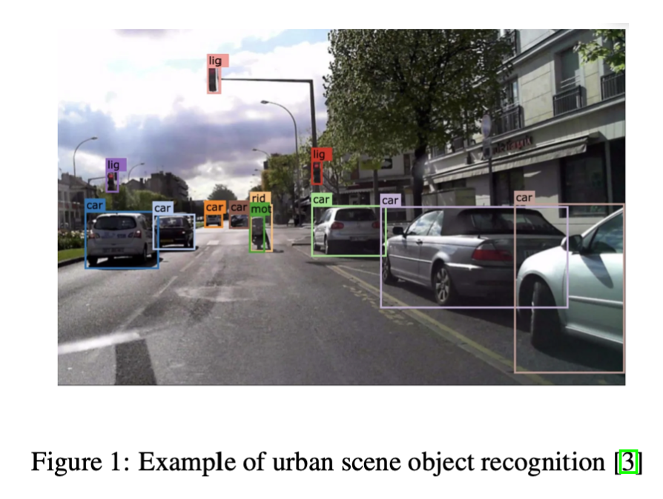
Problem Definition
Object recognition in autonomous driving
Importance of detecting and classifying objects like pedestrians, vehicles, and traffic signs
Focus on bounding boxes for object detection

Slide 5
Background
Introduction to the YOLO model
Advantages of YOLO in real-time object detection
Metrics used: Intersection over Union (IoU) and Mean Average Precision (mAP)

Slide 6
Outline
Problem Definition
Dataset and Experimental Setup
YOLO Model Architecture
Results and Comparison
Future Work
References

Slide 7
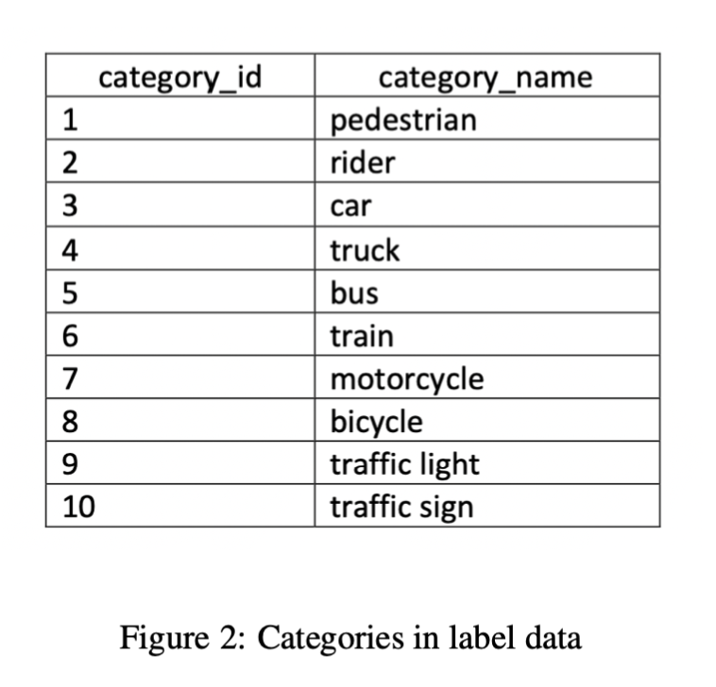
Dataset
Berkeley DeepDrive 100K (BDD100K) dataset
100,000 images from various urban environments
Training (70K), validation (10K), and testing (20K) sets

Slide 8
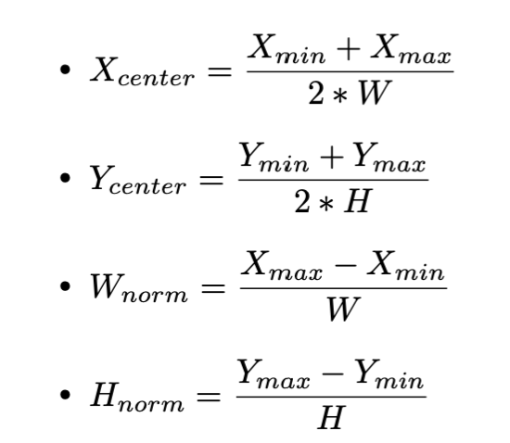
Dataset
The BDD100K dataset represents bounding box coordinates using the format [Xmin, Ymin, Xmax, Ymax]
Conversion of annotations to YOLO format:

Slide 9
Experimental Setup
Hardware: NVIDIA RTX 3070 GPU,
Language: Python
Framework: PyTorch framework
Benefits of using PyTorch: - Dynamic computation graphs - Flexibility - Strong community support

Slide 10
Outline
Problem Definition
Dataset and Experimental Setup
YOLO Model Architecture
Results and Comparison
Future Work
References

Slide 11
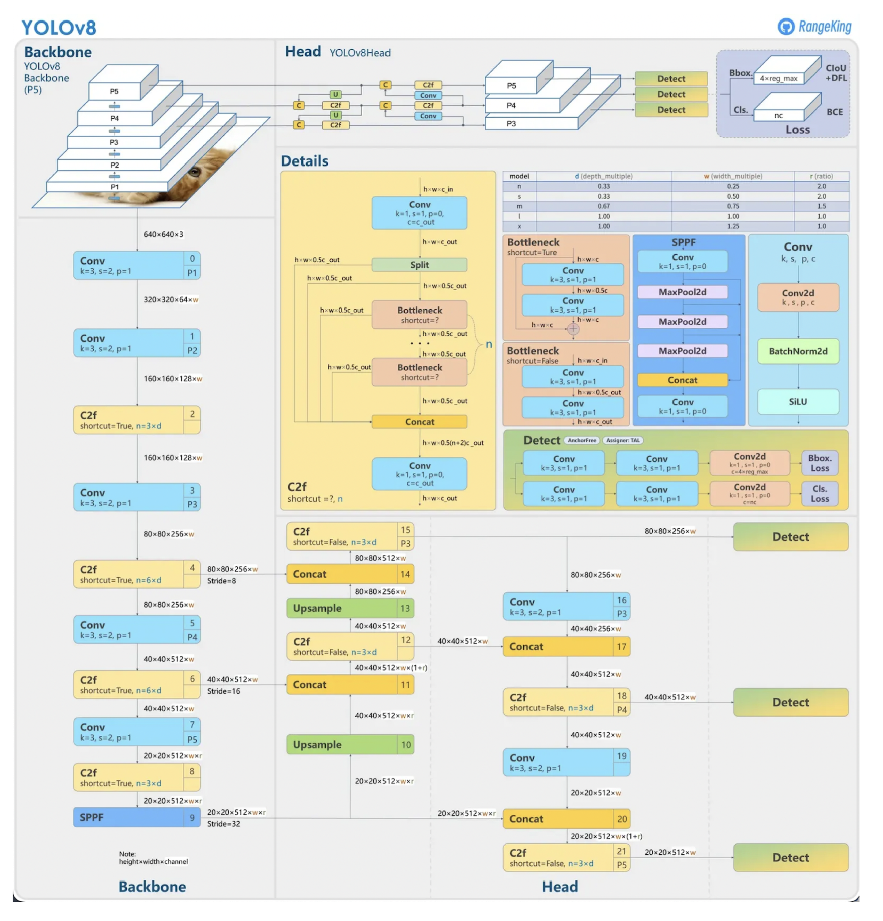
YOLO Model Architecture (YOLOv8)
YOLO stands for "You Only Look Once.”
It is a real-time object detection system using one stage detector.
Detection head with dynamic anchor assignment and IoU loss function
Using CSPDarknet53 as its backbone

Slide 12
YOLOv8 Improvements
Stem tweak: Reducing the first convolutional kernel size from 6×6 to 3×3 for efficient image abstraction which facilitates faster inference speed.
Backbone bottleneck tweak: Upscalingthefirstconvo- lutional kernel in the bottleneck area from 1×1 to 3×3 for better feature extraction.
Anchor-free detection head: Implementing a novel anchor-free head for object detection, eliminating the need for predefined anchor boxes which contributes to higher ac- curacy compared to earlier versions
New loss function: Utilizing a modified loss function focusing on both bounding box location and classification confidence.

Slide 13
Outline
Problem Definition
Dataset and Experimental Setup
YOLO Model Architecture
Results and Comparison
Future Work
References

Slide 14
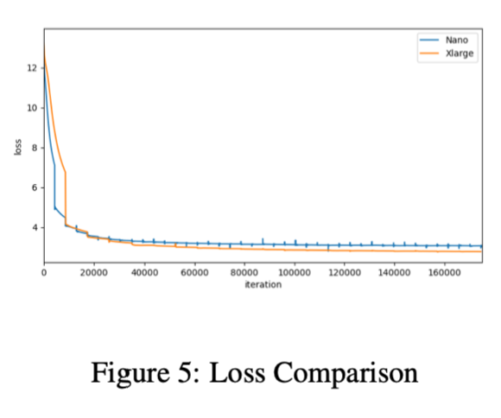
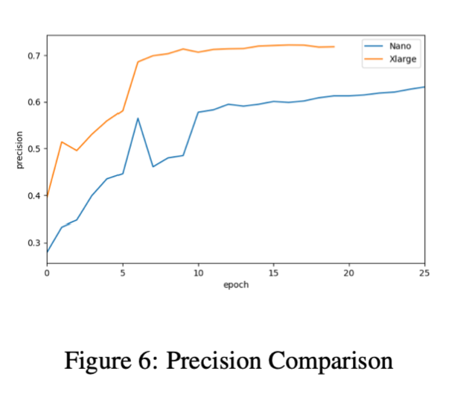
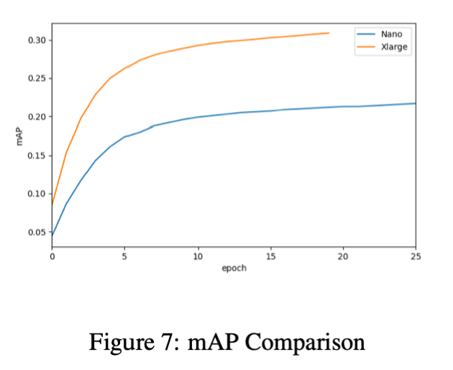
Results
Comparison of YOLOv8 Nano and XLarge variants
YOLOv8 XLarge: Precision 0.71, mAP 30.8%
YOLOv8 Nano: Precision 0.67, mAP 24.7%

Slide 15
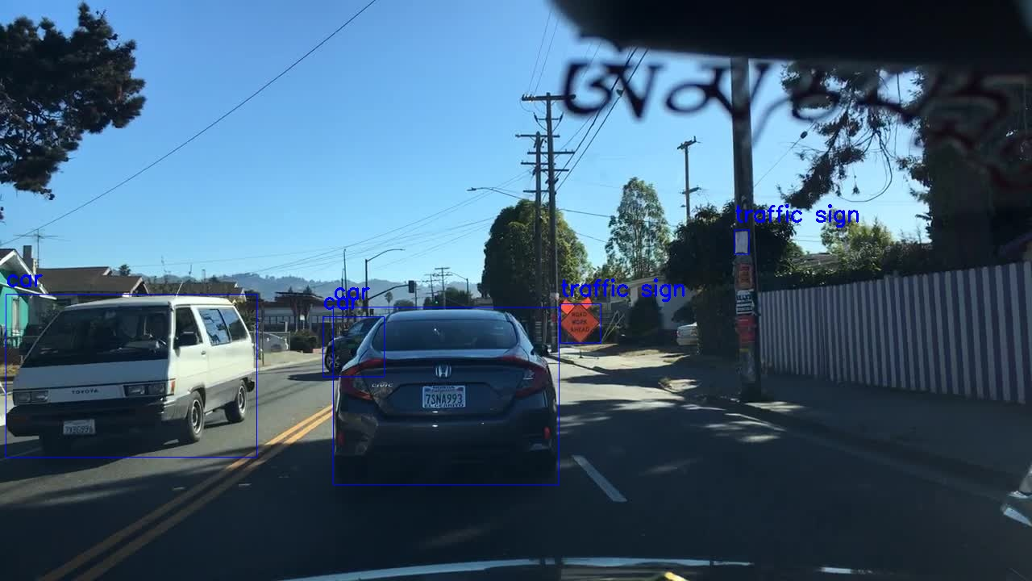
Comparison
Nano

Slide 16

Comparison
XLarge

Slide 17
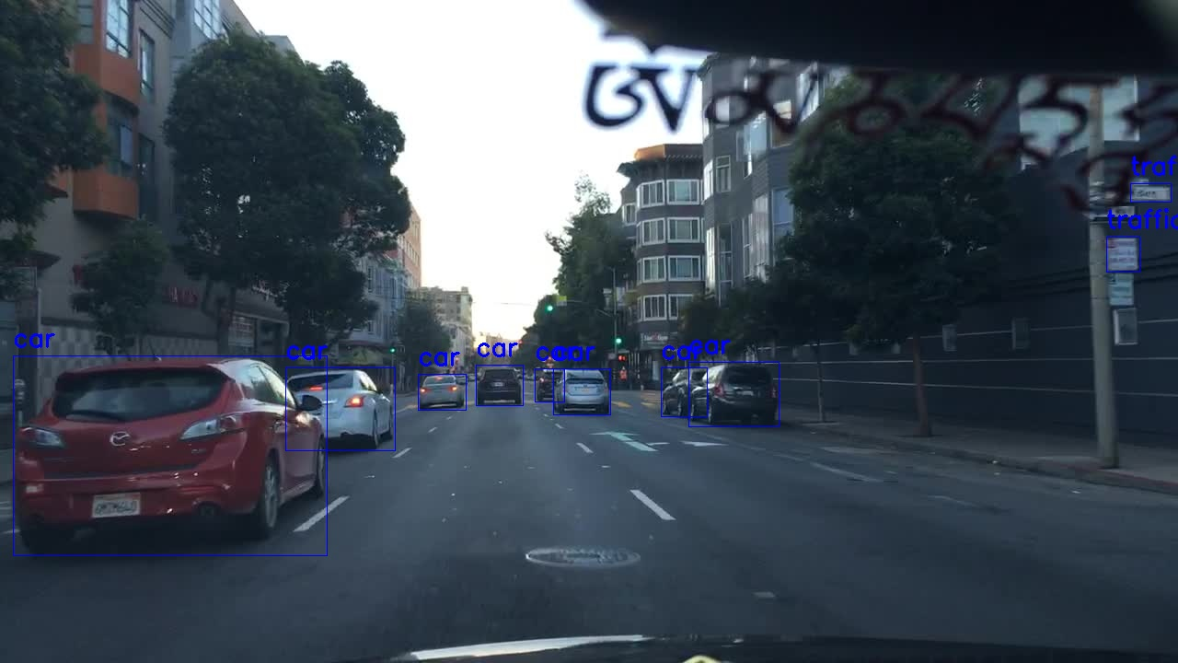
Comparison
Nano

Slide 18

Comparison
XLarge

Slide 19
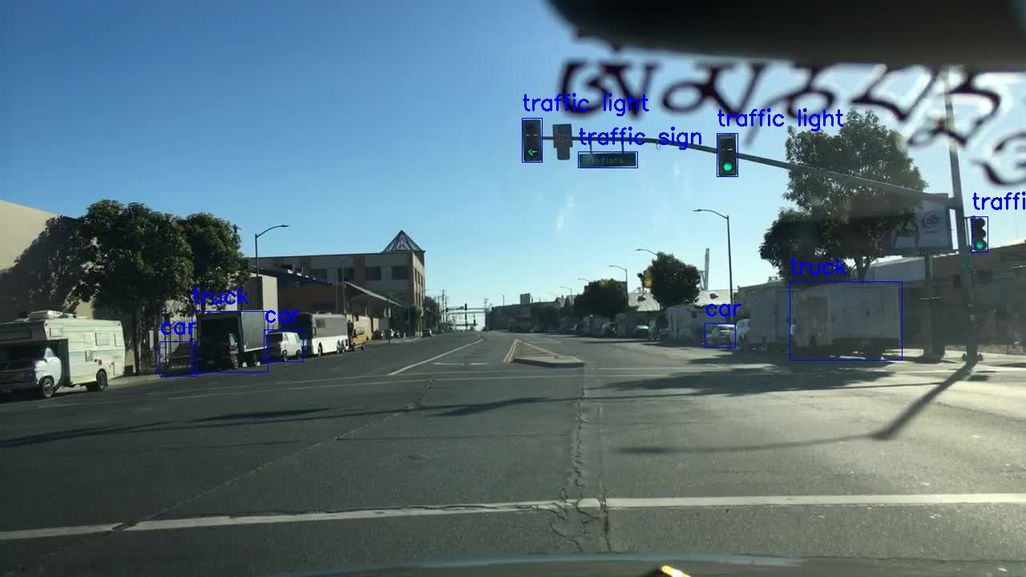
Comparison
Nano

Slide 20

Comparison
XLarge

Slide 21
Outline
Problem Definition
Dataset and Experimental Setup
YOLO Model Architecture
Results and Comparison
Future Work
References

Slide 22
Future Work
Upgrade hardware by increasing the efficiency and memory of GPU
Achieve real-time segmentation
Tune parameters to find the best performance
Try more classes or use a different dataset
Explore different models

Slide 23
Outline
Problem Definition
Dataset and Experimental Setup
YOLO Model Architecture
Results and Comparison
Future Work
References

Slide 24
References
[1] J. Redmon, S. Divvala, R. Girshick, and A. Farhadi. You only look once: Unified, real-time object detection. Proceedings of the IEEE conference on computer vision and pattern recognition, 2016.
[2] J. Solawetz and Francesco. What is yolov8? the ulti- mate guide. 2023, Jan 11. Accessed on 2024.
[3] C. Wang, I. Yeh, and H. M. Liao. Yolov9: Learning what you want to learn using programmable gradient information. CoRR, abs/2402.13616, 2024.
[4] F. Yu, H. Chen, X. Wang, W. Xian, Y. Chen, F. Liu, V. Madhavan, and T. Darrell. Bdd100k: A diverse driv- ing dataset for heterogeneous multitask learning. 2020 IEEE/CVF Conference on Computer Vision and Pattern Recognition (CVPR), pages 2633–2642, 2018.

Slide 25
Thank you
for you listening.

